Slide 1
Production
Lecturer: Ngo Huy Bien
Software Engineering Department
Faculty of Information Technology
VNUHCM - University of Science
Ho Chi Minh City, Vietnam
nhbien@fit.hcmus.edu.vn

Slide 2

Objectives

Slide 3

Contents

Slide 4

References
Kirupa Chinnathambi (2018). Learning React: A Hands-On Guide to Building Web Applications Using React and Redux. Addison-Wesley Professional.

Slide 5
1. Create Node.js Web App

Slide 6
2. Add Environment Variables
#package.json
"dependencies": {
...
"react": "^16.13.1",
"react-dom": "^16.13.1",
"react-scripts": "^3.4.3",
...
"dotenv": "^8.2.0"
},
my-react-app/ |-node-modules/ |-src/ |-public/ |-.env |-.gitignore |-package.json |-package.lock.json. |-README.md
#.env
REACT_APP_CLIENT_ID=jfjffffaddfe REACT_APP_KEY=aaddddawrfffvvv
#code
console.log(process.env.REACT_APP_CLIENT_ID); console.log(process.env.REACT_APP_KEY);

Slide 7
3. Create .gitignore
my-react-app/ |-node-modules/ |-src/ |-public/ |-.env |-.gitignore |-package.json |-package.lock.json. |-README.md
# dependencies
/node_modules
# testing
/coverage
# production
/build
# misc
.DS_Store
.env
#<--------Put the custom env files here
.env.local
.env.development.local
.env.test.local
.env.production.local
npm-debug.log*
yarn-debug.log*
yarn-error.log*

Slide 8
4. Configure CORS
In an SPA, the browser loads one initial HTML document — for example: https://app.example.com/index.html
That document’s origin is (https, app.example.com, 443).
Even though the SPA dynamically changes routes and content, the browser keeps the same origin context.
Even though the SPA seems to “stay in memory,” the browser still considers it a web document loaded from its original URL.
For an SPA, the JavaScript’s origin is the same as the origin of the single HTML page that was initially loaded.

Slide 9
Special case: "local" files (file://)
If you open an SPA directly from your file system, e.g.: file:///Users/bien/index.html
then its origin is "opaque".
Origin used by JS is Opaque origin
Origin header value is Origin: null
It has no host component and cannot access any network resources via CORS, unless those servers explicitly allow requests from null origin.

Slide 10


Slide 11
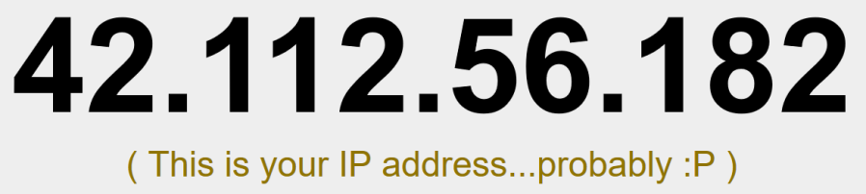
Using XMLHttpRequest
...
var xhr;
class IPAddressContainer extends React.Component {
constructor(props) {
super(props);
this.state = {
ip_address: "..."
};
this.processRequest = this.processRequest.bind(this);
}
componentDidMount() {
xhr = new XMLHttpRequest();
xhr.open("GET", "https://ipinfo.io/json", true);
xhr.onreadystatechange = this.processRequest;
// xhr.addEventListener("readystatechange", this.processRequest, false);
xhr.send();
}
processRequest = function() {
if (xhr.readyState === 4 && xhr.status === 200) {
var response = JSON.parse(xhr.responseText);
this.setState({
ip_address: response.ip
});
}
};
...

Slide 12
Presentational vs. Container Components
In our React apps, we have been primarily dealing with two types of components:
Components that deal with how things look. These are better known as presentational components.
Components that perform some under-the-covers processing. Examples of this processing include routing, increasing a counter, fetching data via a HTTP request, and so on. You will see these components referred to as container components.

Slide 13
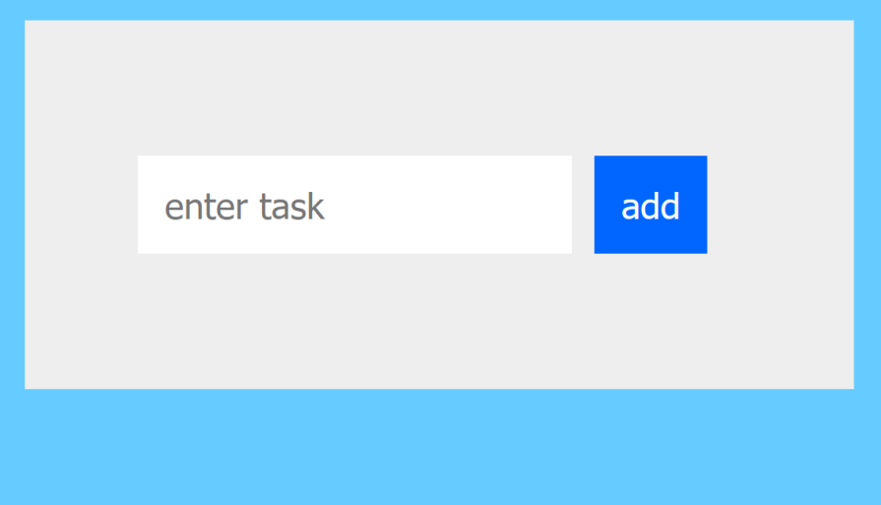
3. Create ToDo List App Sketch
...
class TodoList extends React.Component{
constructor(props) {
super(props);
this.state = {
items: []
};
this.addItem = this.addItem.bind(this);
}
addItem(e) {
}
render() {
return (
<div className="todoListMain">
<div className="header">
<form onSubmit={this.addItem}>
<input ref={(a) => this._inputElement = a}
placeholder="enter task" />
<button type="submit">add</button>
</form>
...
var destination = document.querySelector("#container");
ReactDOM.render(
<TodoList />,
...

Slide 14
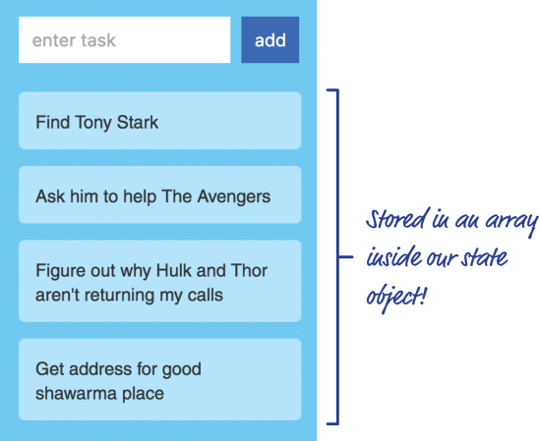
4. Create Task Array (Model)
...
addItem(e) {
var itemArray = this.state.items;
itemArray.push(
{
text: this._inputElement.value,
key: Date.now()
}
);
this.setState({
items: itemArray
});
this._inputElement.value = "";
e.preventDefault();
{/* Stop the onSubmit event from performing
the default behavior (POST action). */}
}
render() {
return (
<div className="todoListMain">
<div className="header">
<form onSubmit={this.addItem}>
<input ref={(a) => this._inputElement = a}
placeholder="enter task" />
<button type="submit">add</button>
...

Slide 15
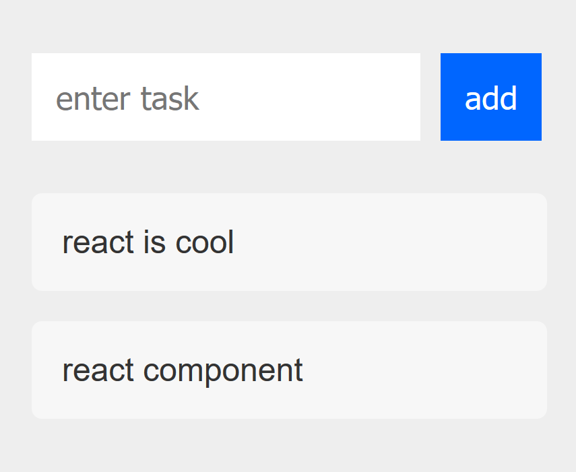
5. Create UI
...
class TodoItems extends React.Component{
constructor(props) {
super(props);
this.createTasks = this.createTasks.bind(this);
}
createTasks(item) {
return <li key={item.key}>{item.text}</li>
}
render() {
var todoEntries = this.props.entries;
var listItems = todoEntries.map(this.createTasks);
{/* Using the map function to iterate every item
inside todoEntries and call the createTasks function
to create a list element for each entry */}
return (
<ul className="theList">
{listItems}
</ul>
);
}
}
...
<form onSubmit={this.addItem}>
<input ref={(a) => this._inputElement = a}
placeholder="enter task" />
<button type="submit">add</button>
</form>
</div>
<TodoItems entries={this.state.items} />
...

Slide 16
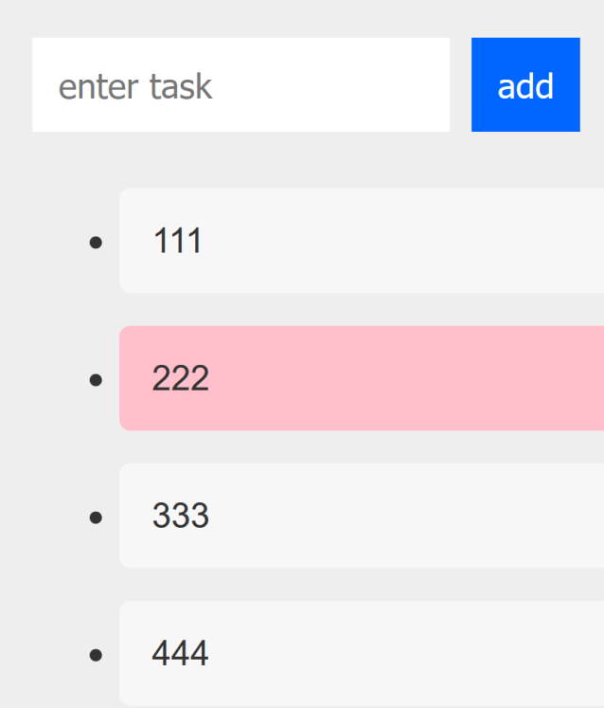
6. Implement Deletion
...
class TodoItems extends React.Component{
...
/* Define the delete event handler.
Our delete function doesn't actually do any deleting.
It just calls another delete function passed into this component via props. */
delete(key) {
this.props.delete(key);
}
createTasks(item) {
return <li onClick={() => this.delete(item.key)}
key={item.key}>{item.text}</li>
}
...
deleteItem(key) {
var filteredItems = this.state.items.filter(function(item) {
return (item.key !== key);
});
this.setState({
items: filteredItems
});
}
...
<TodoItems entries={this.state.items}
delete={this.deleteItem} />
</div>
);
}
...

Slide 17
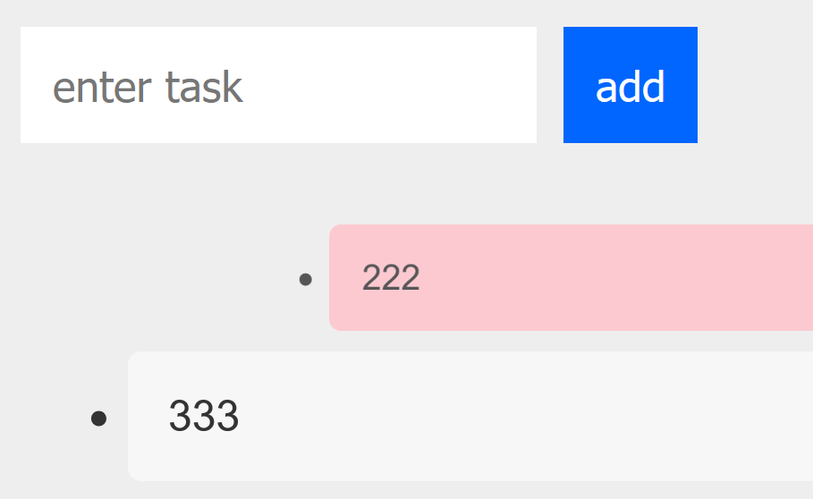
7. Use Flip Move
...
<script src="https://cdnjs.cloudflare.com/ajax/libs/react-flip-move/3.0.3/react-flip-move.min.js"></script>
...
return (
<ul className="theList">
<FlipMove duration={250} easing="ease-out">
{listItems}
</FlipMove>
</ul>
);
...

Slide 18
Creating a Sliding Menu in React

Slide 19
Avoiding Unnecessary Renders in React

Slide 21
Rendering Components Dynamically
By utilizing JSX and React.createElement, we can render content with specific components and layouts by only using their name.

Slide 22
1. Create Foo Component
import React from "react";
const Foo = (props) => (
<div>
<hr />
Hi I'm a Foo component with the headline:
<h2>{props.componentBlock.headline}</h2>
</div>
);
export default Foo;

Slide 23
2. Create Bar Component
import React from "react";
const Bar = (props) => (
<div>
<hr />
Hi I'm a Bar component with the headline:
<h2>{props.componentBlock.headline}</h2>
</div>
);
export default Bar;

Slide 24
3. Prepare Configuration Data
const data = {
content: {
body: [
{
_uid: "BUY6Drn9e1",
type: "foo",
headline: "Foo headline"
},
{
_uid: "gJZoSLkfZV",
type: "foo",
headline: "Another Foo headline"
},
{
_uid: "X1JAfdsZxy",
type: "bar",
headline: "Bar headline"
}
]
}
};

Slide 25
4. Render Component Type
function App() {
return (
<div className="App">
{data.content.body.map(component => component.type)}
</div>
)
}

Slide 26
5. Create Component Render
import React from "react";
import Foo from "./Foo";
import Bar from "./Bar"; const Components = {
foo: Foo,
bar: Bar
}; const ComponentRenderer = (component) => {
// component does exist
if (typeof Components[component.type] !== "undefined") {
return React.createElement(Components[component.type], {
key: component._uid,
componentBlock: component
});
}
...
} export default ComponentRenderer;

Slide 27
6. Render Components
function App() {
return (
<div className="App">
{data.content.body.map(component => ComponentRenderer(component))}
</div>
)
}

Slide 29
1. Prepare Data
const Data = [
{
id: "1",
name: "Davido",
country: "Nigeria",
genre: "Afro-Pop",
albums: "2"
},
...
{
id: "4",
name: "Sauti Sol",
country: "Kenya",
genre: "Soul",
albums: "3"
}
];
export default Data;

Slide 30
2. Render Data
import data from "./Data";
export default function Artists() {
return (
<>
<h1>MTV Base Headline Artists 2019</h1>
{data.map(artist => (
<div key={artist.id}>
<h2>{artist.name}</h2>
<p>genre: {artist.genre}</p>
<p>Albums released: {artist.albums}</p>
<hr />
</div>
))}
</>
);
}

Slide 31
3. Import Component Statically
import Artists from "./Artists";
function App() {
return (
<div>
<Artists />
</div>
);
}
export default App;

Slide 32
4. Import Component Dynamically
import React, { lazy, Suspense } from "react";
const Artists = lazy(() => import("./Artists"))
function App() {
return (
<div>
<Suspense fallback={<h1>Still Loading...</h1>}>
<Artists />
</Suspense>
</div>
);
}
export default App;

Slide 33
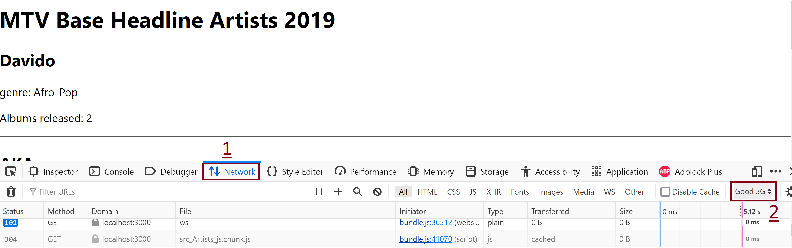
5. Test Component Import

Slide 34

Thank You & See You Again

